Slide 1

Data SCIENCE
Training

Slide 2
COURSE OUTCOME
Data SCIENCE PROCESS & METHODLOGY
PROGRAMMING & PRODUCTIONALIZATION
BUSINESS APPLICATION

Slide 3
Training Curriculum – 2 months
Understanding of concepts: AI/ML/Data Science/DL
Basic Statistics for ML (Data types, Bayesian, hypothesis testing, Pattern Visualization)
Data Science Model Process(Data Preparation, Feature building, model development, model evaluation, model deployment)
Machine Learning (Supervised, Unsupervised, Reinforcement Learning)
Classification
Clustering
Decision Tree & Ensemble Models
Regression
Anomaly Detection
NLP Concepts & application(Word Embedding, LSTM, GRU, Seq2Seq, Chatbots)
Deep Learning concepts & application(Neural Network models - CNN, LSTM, GAN, AutoEncoder)
Computer Vision & application(Object Detection, Image Analytics, Audio & Video Analytics)
ML in Edge Analytics ( Mobile, Wearable, IoT), Mobile and Browser
Application of ML/AI in functional areas (Finance, Supply Chain, Sales & Marketing , Services)
Data Science Infrastructure and platforms (Cloud platforms, COTS products, open sources)
Data Science Business Approach Framework ( from identifying the business case to Productionalization)
Month-1
Month-2

Slide 4
Machine Learning: How different it is
Software Process
Machine Learning Process
Input
Code
Input
ML
Region, Customer, Orders
Output
Region, Customer, Orders
Business Rules
Business Rules
Sales Forecasting
Output
ML Driven Rules
Given by functional team
Historical Sales Forecasting

Slide 5
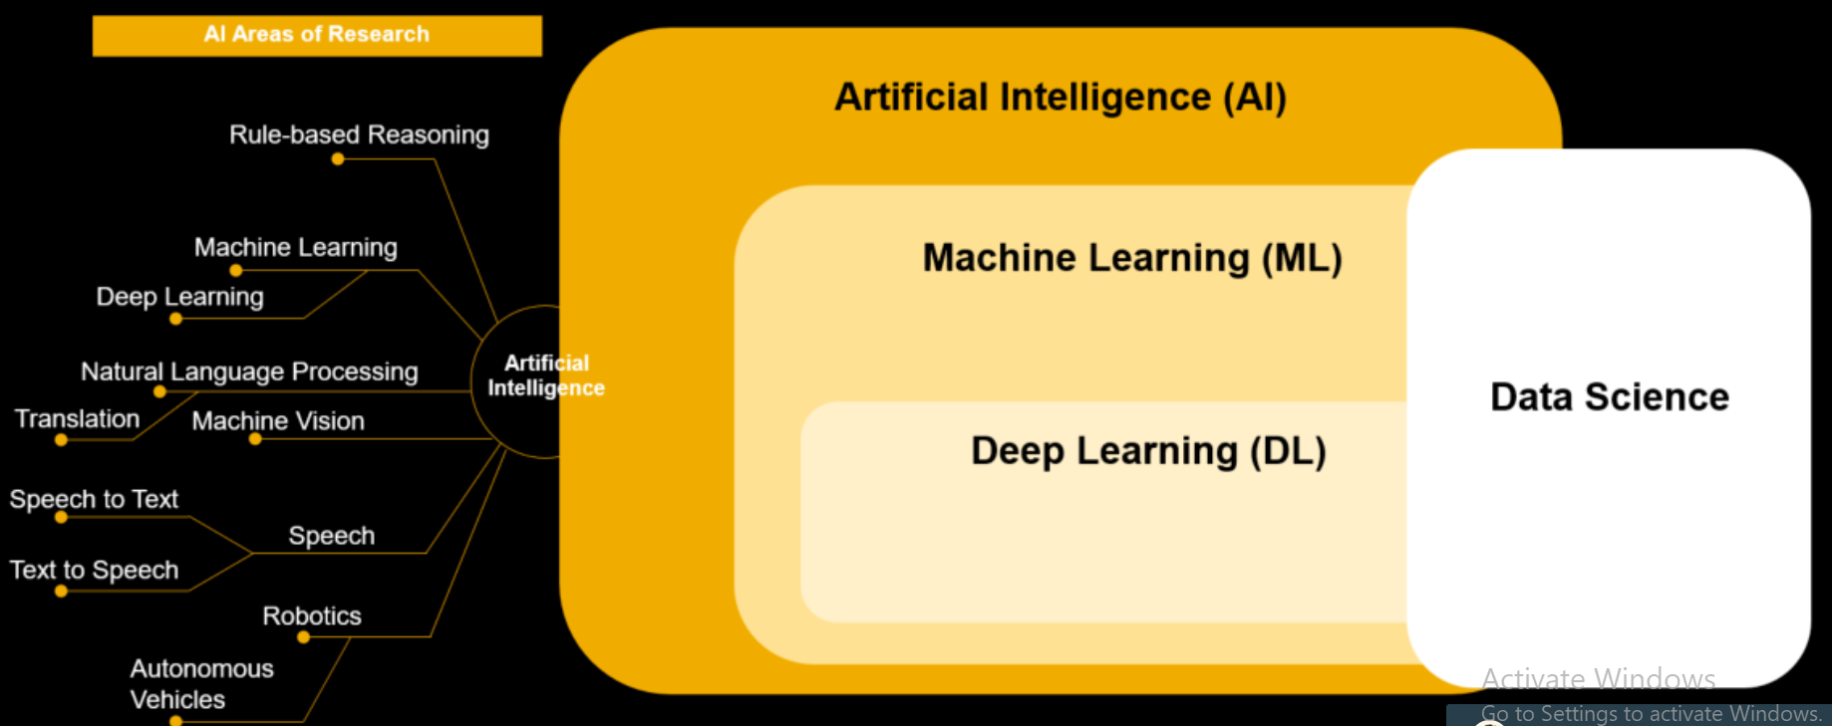
Data Science/ML/DL/AI

Slide 6
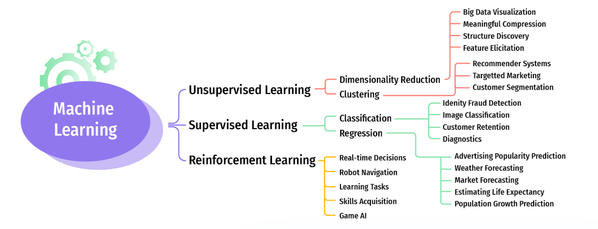
Machine Learning - Types

Slide 7
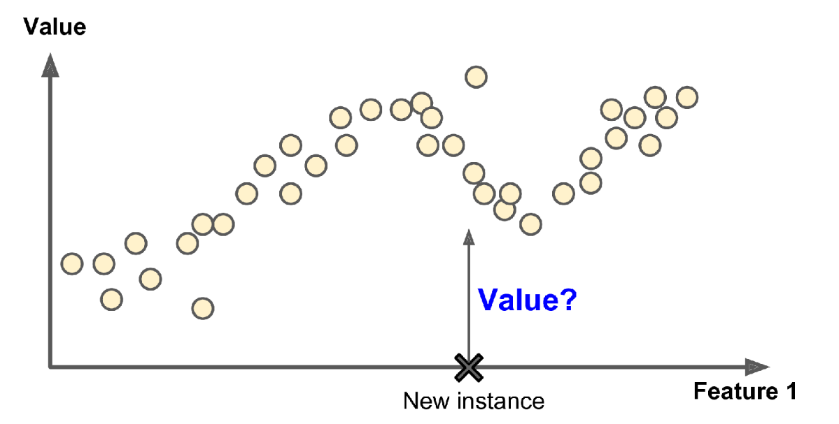
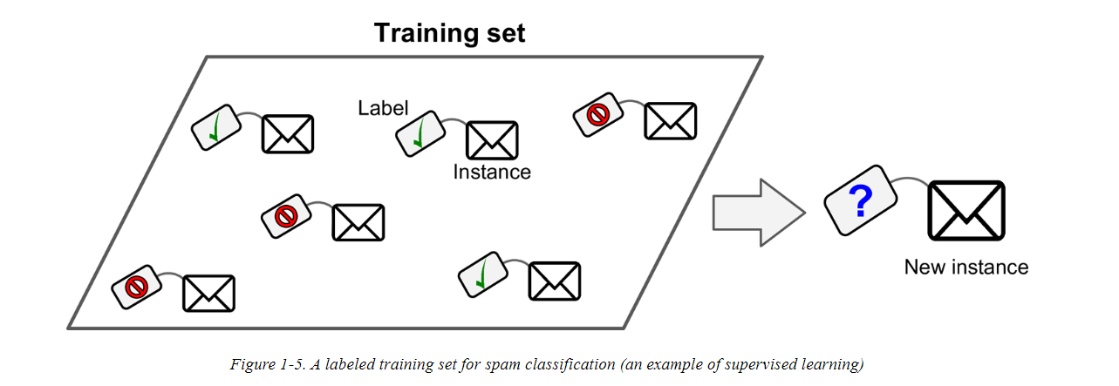
Supervised Learning
k-Nearest Neighbors
Linear Regression
Logistic Regression
Support Vector Machines (SVMs)
Decision Trees and Random Forests
Neural networks^{2bn}
Regression
Classification

Slide 8
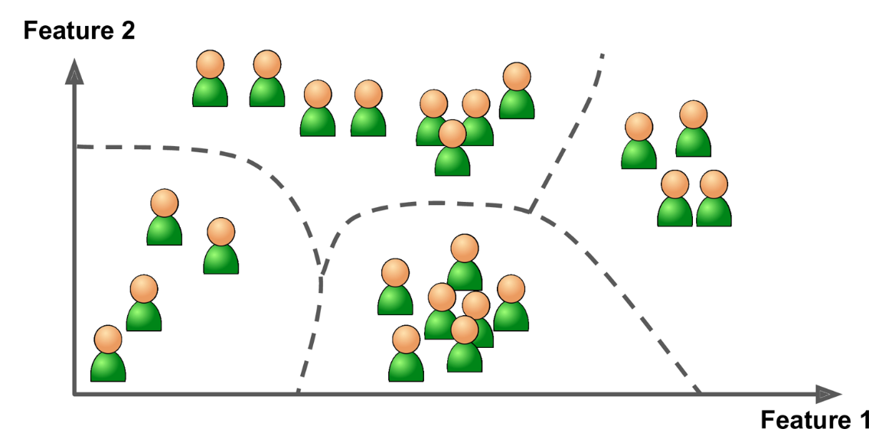
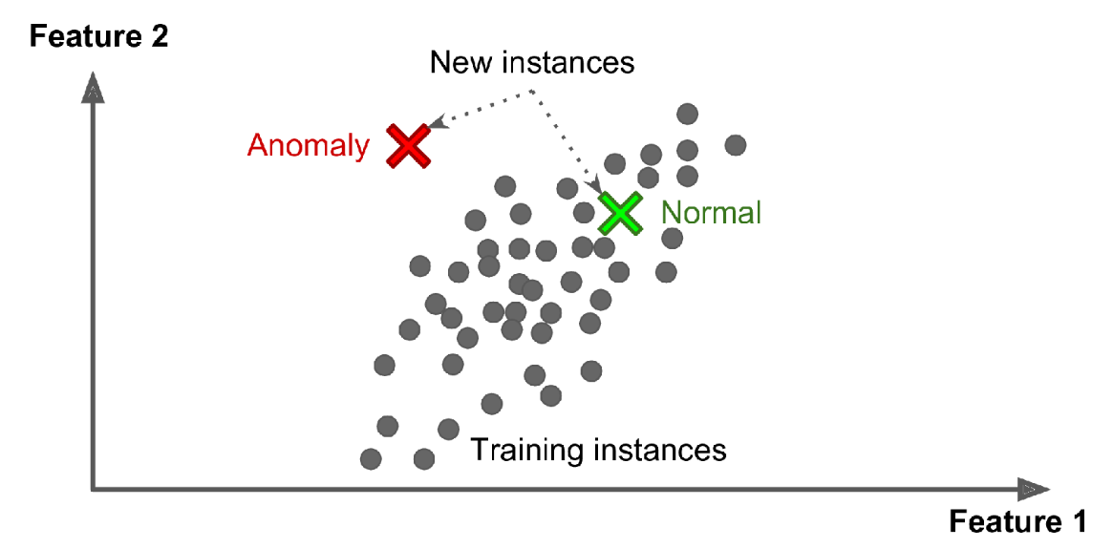
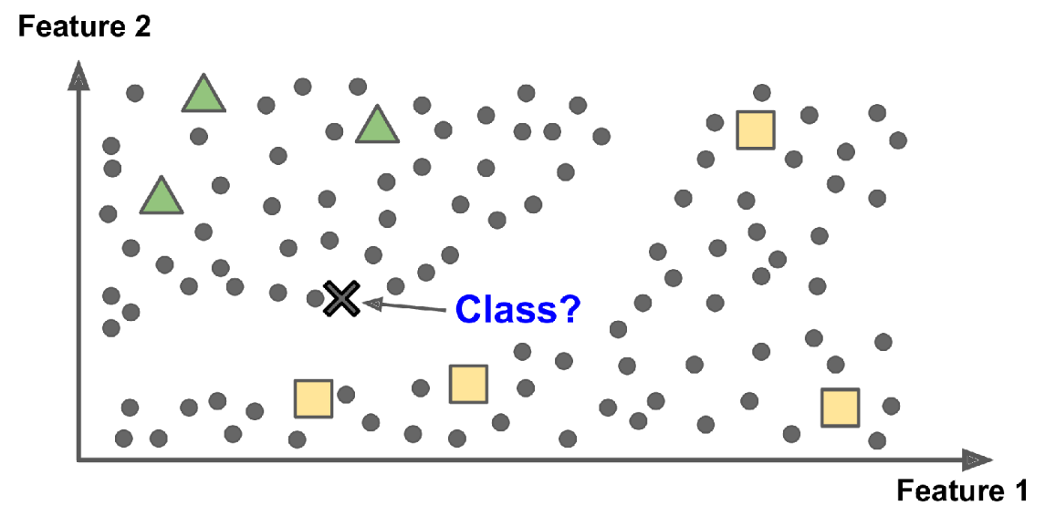
Unsupervised Learning
Clustering
Anomaly Detection
Semi-Supervised Learning

Slide 9
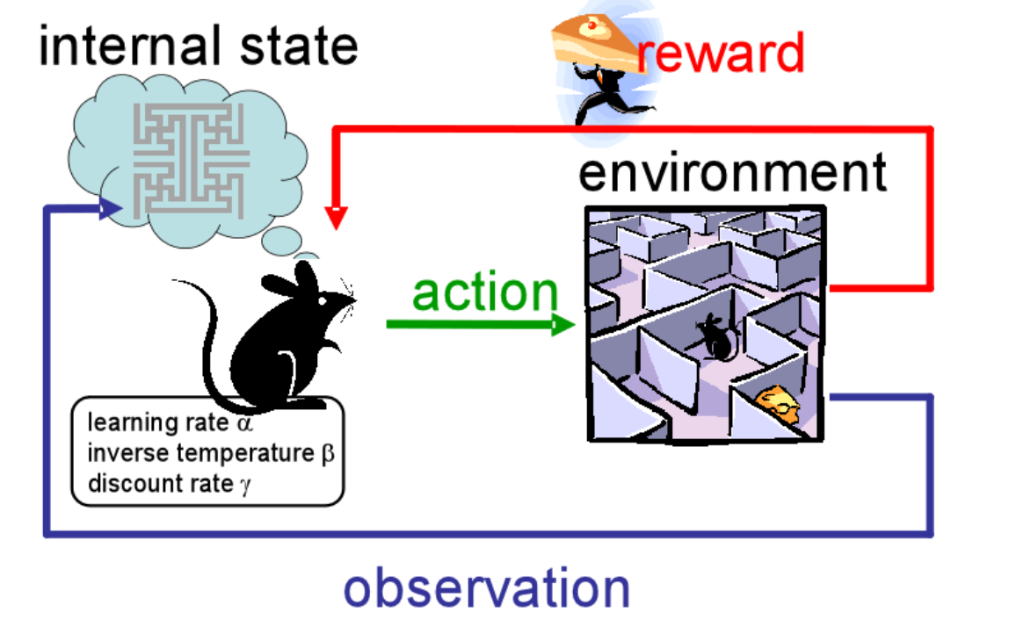
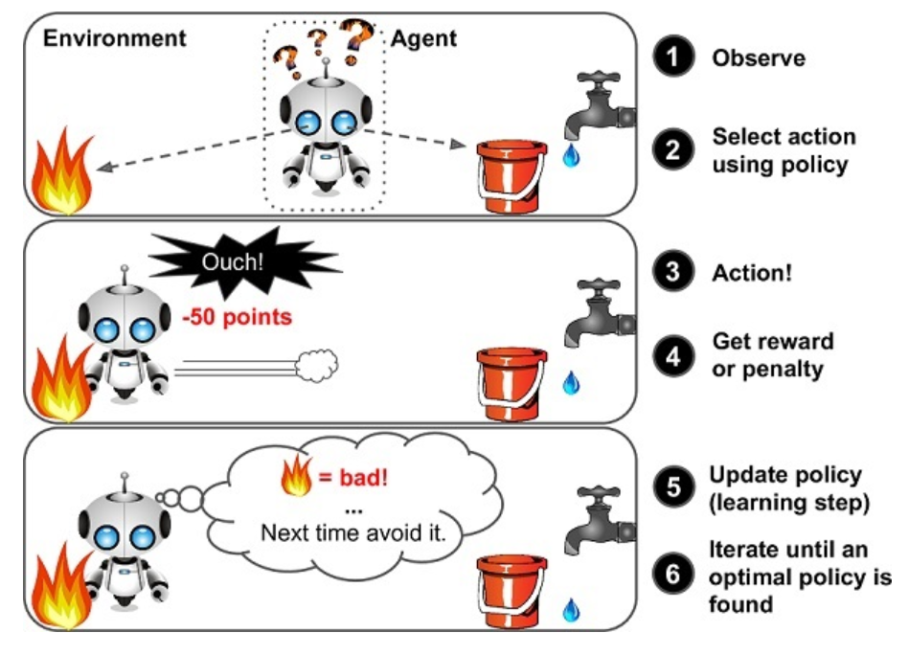
Reinforcement Learning

Slide 10
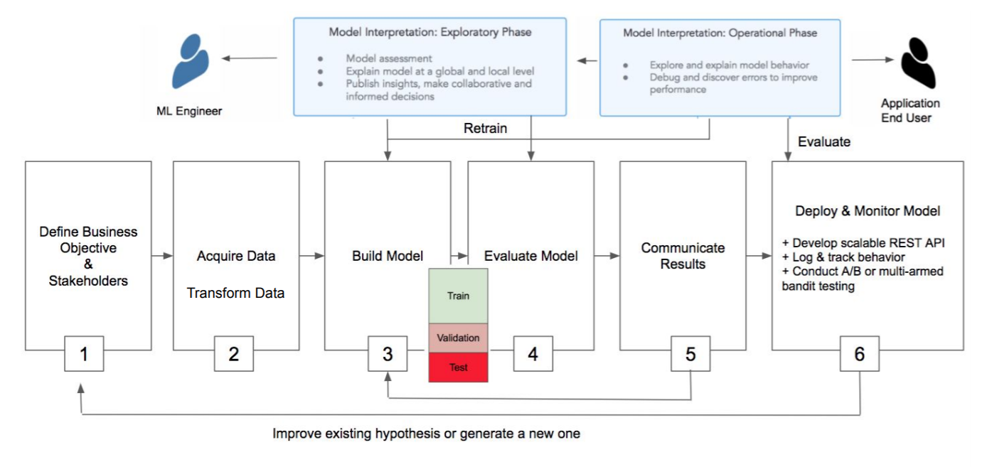
Data Science Workflow

Slide 11
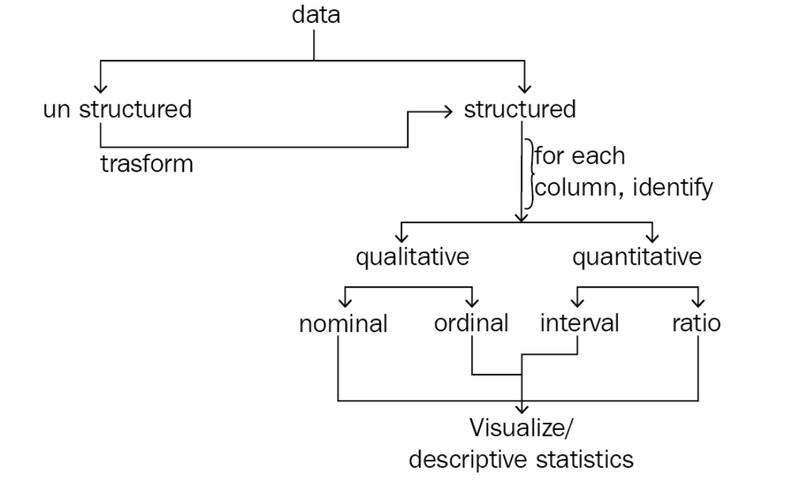
Data Preparation & Exploration

Slide 12
Qualitative Vs Quantitative Data
Quantitative data: This data can be described using numbers, and basic mathematical procedures, including addition, are possible on the set.
Qualitative data: This data cannot be described using numbers and basic mathematics. This data is generally thought of as being described using natural categories and language.
Name of coffee shop
Revenue (in thousands of dollars)
Zip code
Average monthly customers
Country of coffee origin

Slide 13
Data Levels
Level of Measurement | Properties | Examples | Descriptive statistics | Graphs
Nominal | Discrete Orderless | Binary Responses (True or False) Names of People Colors of paint | Frequencies/Percentages Mode | Bar Pie
Ordinal | Ordered categories Comparisons | Likert Scales Grades on an exam | Frequencies Mode Median Percentiles | Bar Pie Stem and leaf
Interval | Differences between ordered values have meaning | Deg. C or F Some Likert Scales (must be specific) | Frequencies Mode Median Mean Standard Deviation | Bar Pie Stem and leaf Box plot Histogram
Ratio | Continuous True 0 allows ratio statements (for example, $100 is twice as much as $50) | Money Weight | Mean Standard Deviation | Histogram Box plot

Slide 14
Data Wrangling
there are three common tasks involved in the data wrangling process:
Data cleaning
Data transformation
Data enrichment
Human errors: Data is recorded (or even collected) incorrectly, such as putting 100 instead of 1000, or typos. In addition, there may be multiple versions of the same entry recorded, such as New York City, NYC, and nyc
Computer error: Perhaps we weren't recording entries for a while (missing data)
Unexpected values: Maybe whoever was recording the data decided to use ? for a missing value in a numeric column, so now all the entries in the column will be treated as text instead of numeric values
Incomplete information: Think of a survey with optional questions; not everyone will answer them, so we have missing data, but not due to computer or human error
Resolution: The data may have been collected per second, while we need hourly data for our analysis
Relevance of the fields: Often, data is collected or generated as a product of some process rather than explicitly for our analysis. In order to get it to a usable state, we will have to clean it up
Format of the data: The data may be recorded in a format that isn't conducive to analysis, which will require that we reshape it
Misconfigurations in data-recording process: Data coming from sources such as misconfigured trackers and/or webhooks may be missing fields or passing them in the wrong order

Slide 15
Data Cleaning
Renaming
Sorting and reordering
Data type conversions
Deduplicating data
Addressing missing or invalid data
Filtering to the desired subset of data

Slide 16
Data Enrichment
Adding new columns: Using functions on the data from existing columns to create new values
Binning: Turning continuous data or discrete data with many distinct values into range buckets, which makes the column discrete while letting us control the number of possible values in the column
Aggregating: Rolling up the data and summarizing it
Resampling: Aggregating time series data at specific intervals

Slide 17
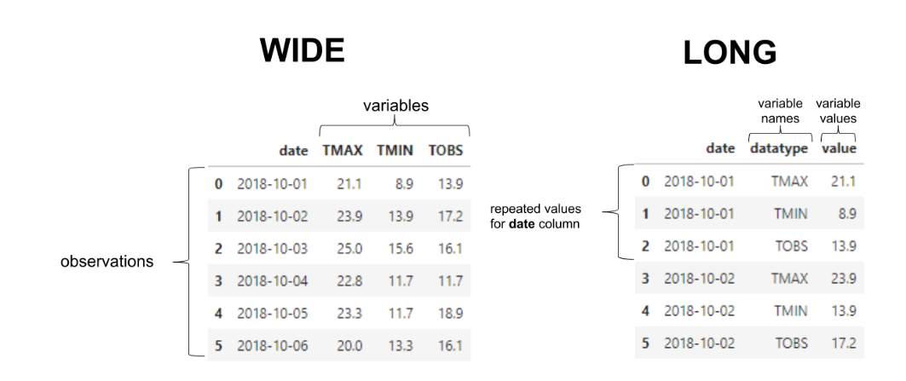
Data Transformation
we focus on changing our data's structure to facilitate our downstream analyses

Slide 18
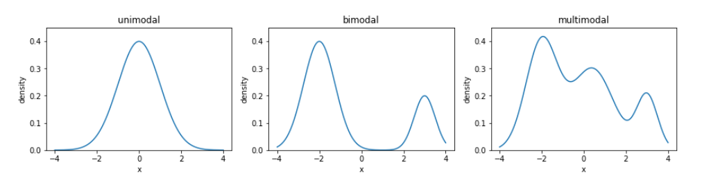
Descriptive Statistics
Measure of Central Tendency: describe the center of our distribution of data – Mean, Median, Mode
Mean – suspect to outliers
Median – when outliers are available, represents the 50th percentile of data.
Mode – when not unimodal

Slide 19
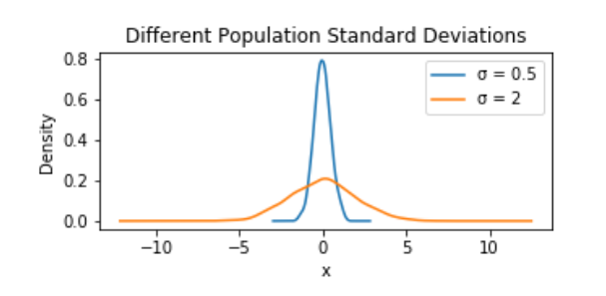
Descriptive Statistics
Measure of Spread: how the data is dispersed. this will indicate how thin (low dispersion) or wide (very spread out) our distribution is
Range : distance between the smallest value (minimum) and the largest value (maximum)
Variance : how far apart observations are spread out from their average value. The variance is calculated as the average squared distance from the mean
Standard Deviation: simply the square root of the variance
Coefficient of Variation: compare the level of dispersion of one dataset to another when unit is not the same. Its standard deviation /mean

Slide 20
Descriptive Statistics
Measure of Position: describe the relative position of a data value of a numerical variable to the other values of the variable.
Measured using Quartiles
Quartiles:
The three values that split a set of ranked data values into four equal parts, or quartiles.
The first quartile, Q₁, is the value such that 25.0% of the ranked data values are smaller and 75.0% are larger
The second quartile, Q₂, splits the ranked values into two equal parts
The third quartile, Q₃, is the value such that 75.0% of the ranked values are smaller and 25.0% are larger.
Lower Quartile (Q1) = (N+1) * 1 / 4
Middle Quartile (Q2) = (N+1) * 2 / 4
Upper Quartile (Q3 )= (N+1) * 3 / 4
Interquartile Range = Q3 – Q1

Slide 21
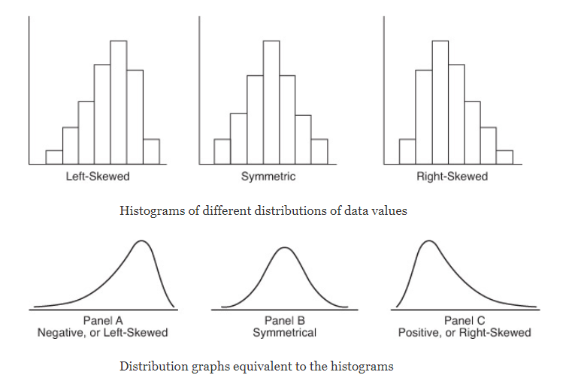
Descriptive Statistics
Symmetrical Shape
Left Skewed: data values in which the mean is less than the median value and the left tail of the distribution is longer than the right tail of the distribution. Negative Skew
Right Skewed: data values in which the mean is greater than the median value and the right tail of the distribution is longer than the left tail of the distribution. Positive Skew

Slide 22
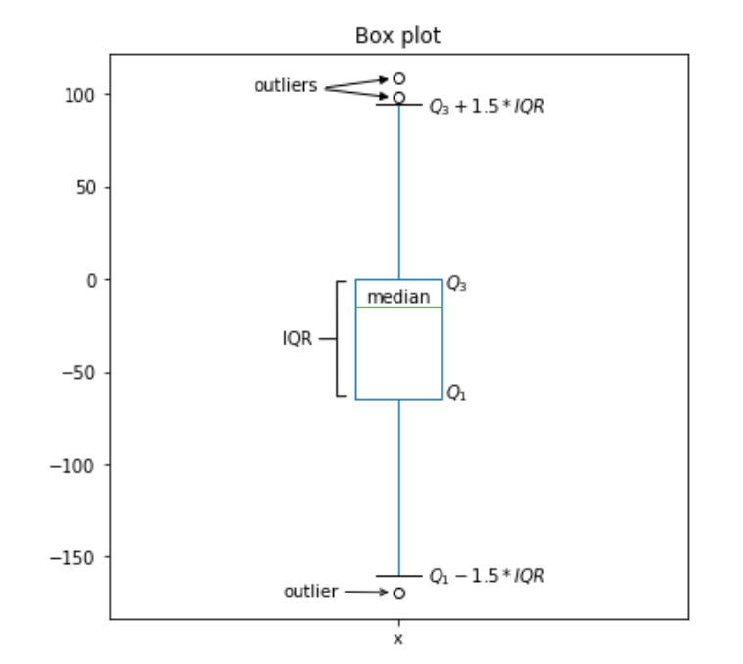
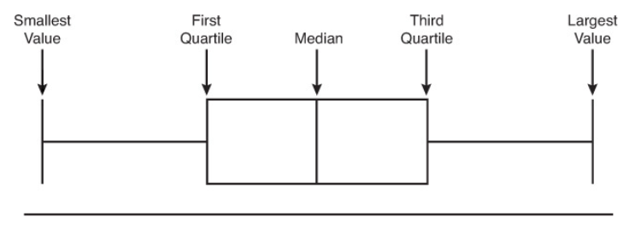
Descriptive Statistics
Box and Whisker Plot

Slide 23
Data Sampling
our sample must be a random sample that is representative of the population
Simple random sample
A teachers puts students' names in a hat and chooses without looking to get a sample of students.
Stratified random sample
A student council surveys 100 students by getting random samples of 25 freshmen, 25 sophomores, 25 juniors, and 25 seniors.
Cluster random sample
Example—An airline company wants to survey its customers one day, so they randomly select 5 flights that day and survey every passenger on those flights.
Systematic random sample
A principal takes an alphabetized list of student names and picks a random starting point. Every 20th student is selected to take a survey.
Bootstrapping Sample: random sampling with replacement

Slide 24
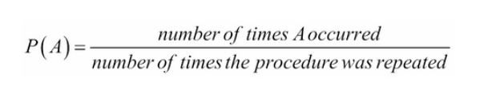
Inferential Statistics - Probabilities
The probability of an event represents the frequency, or chance, that the event will happen.
Frequentist
In a Frequentist approach, the probability of an event is calculated through experimentation. It uses the past in order to predict the future chance of an event.
The relative frequency of an event is how often an event occurs divided by the total number of observations.
Conditional Probabilities: P(A|B) = P(A and B) / P(B)
Gender | Right-handed | Left-handed | Total
Female | 58 | 13 | 71
Male | 47 | 12 | 59
Total | 105 | 25 | 130

Slide 25
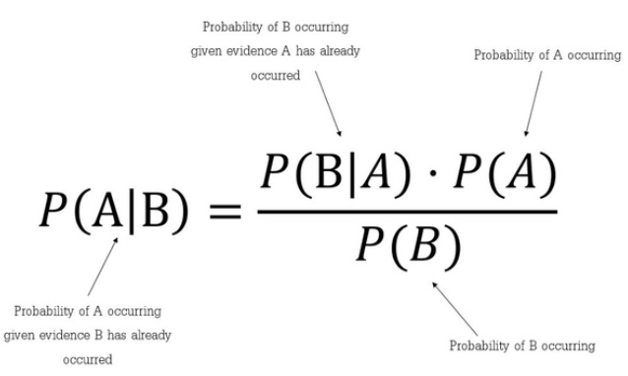
Probabilities - Bayesian
"Bayesian probability" is the process of using probability to try to predict the likelihood of certain events occurring in the future.
A prior distribution
A posterior distribution
A likelihood

Slide 26
Probabilities - Bayes
SpamAssassin works by having users train the system. It looks for patterns in the words in emails marked as spam by the user. For example, it may have learned that the word “free” appears in 20% of the emails marked as spam. Assuming 0.1% of non-spam mail includes the word “free” and 50% of all emails received by the user is spam, find the probability that a mail is a spam if the word “free” appears in it.
P(Free | Spam) = 0.20
P(Free | Non Spam) = 0.001
P(Spam) = 0.50 => P(Non Spam) = 0.50
P(Spam | Free) = ?
Using Bayes’ Theorem:
P(Spam | Free) = P(Spam) * P(Free | Spam) / P(Free)
P(Spam | Free) = 0.50 * 0.20 / (0.50 * 0.20 + 0.50 * 0.001)
P(Spam | Free) = 0.995

Slide 27
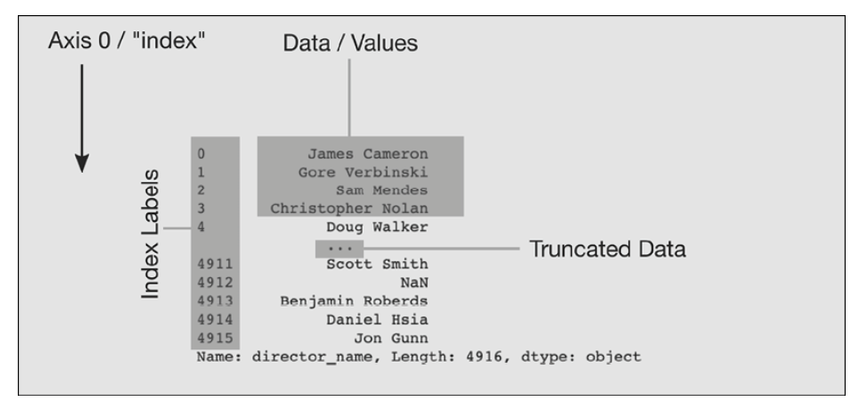
Pandas
df.info()
df.columns
df.head() / df.tail()
df.summary()
Df.shape()
df.dtypes
df.dtypes.value_counts()
Df[“column name”] / df.column_name
Df.loc[:,”column_name”]
Df.isna,fillna, dropna
Df.rename(columns=“new_name”).head()

